Slide 1
Web Services

Slide 2
API – What is an API?
Application Programming Interface

Slide 3

API – What is an API?
Imagine you want to order some food.. With whom do you interact?
Menu
Waiter
Food
You

Slide 4
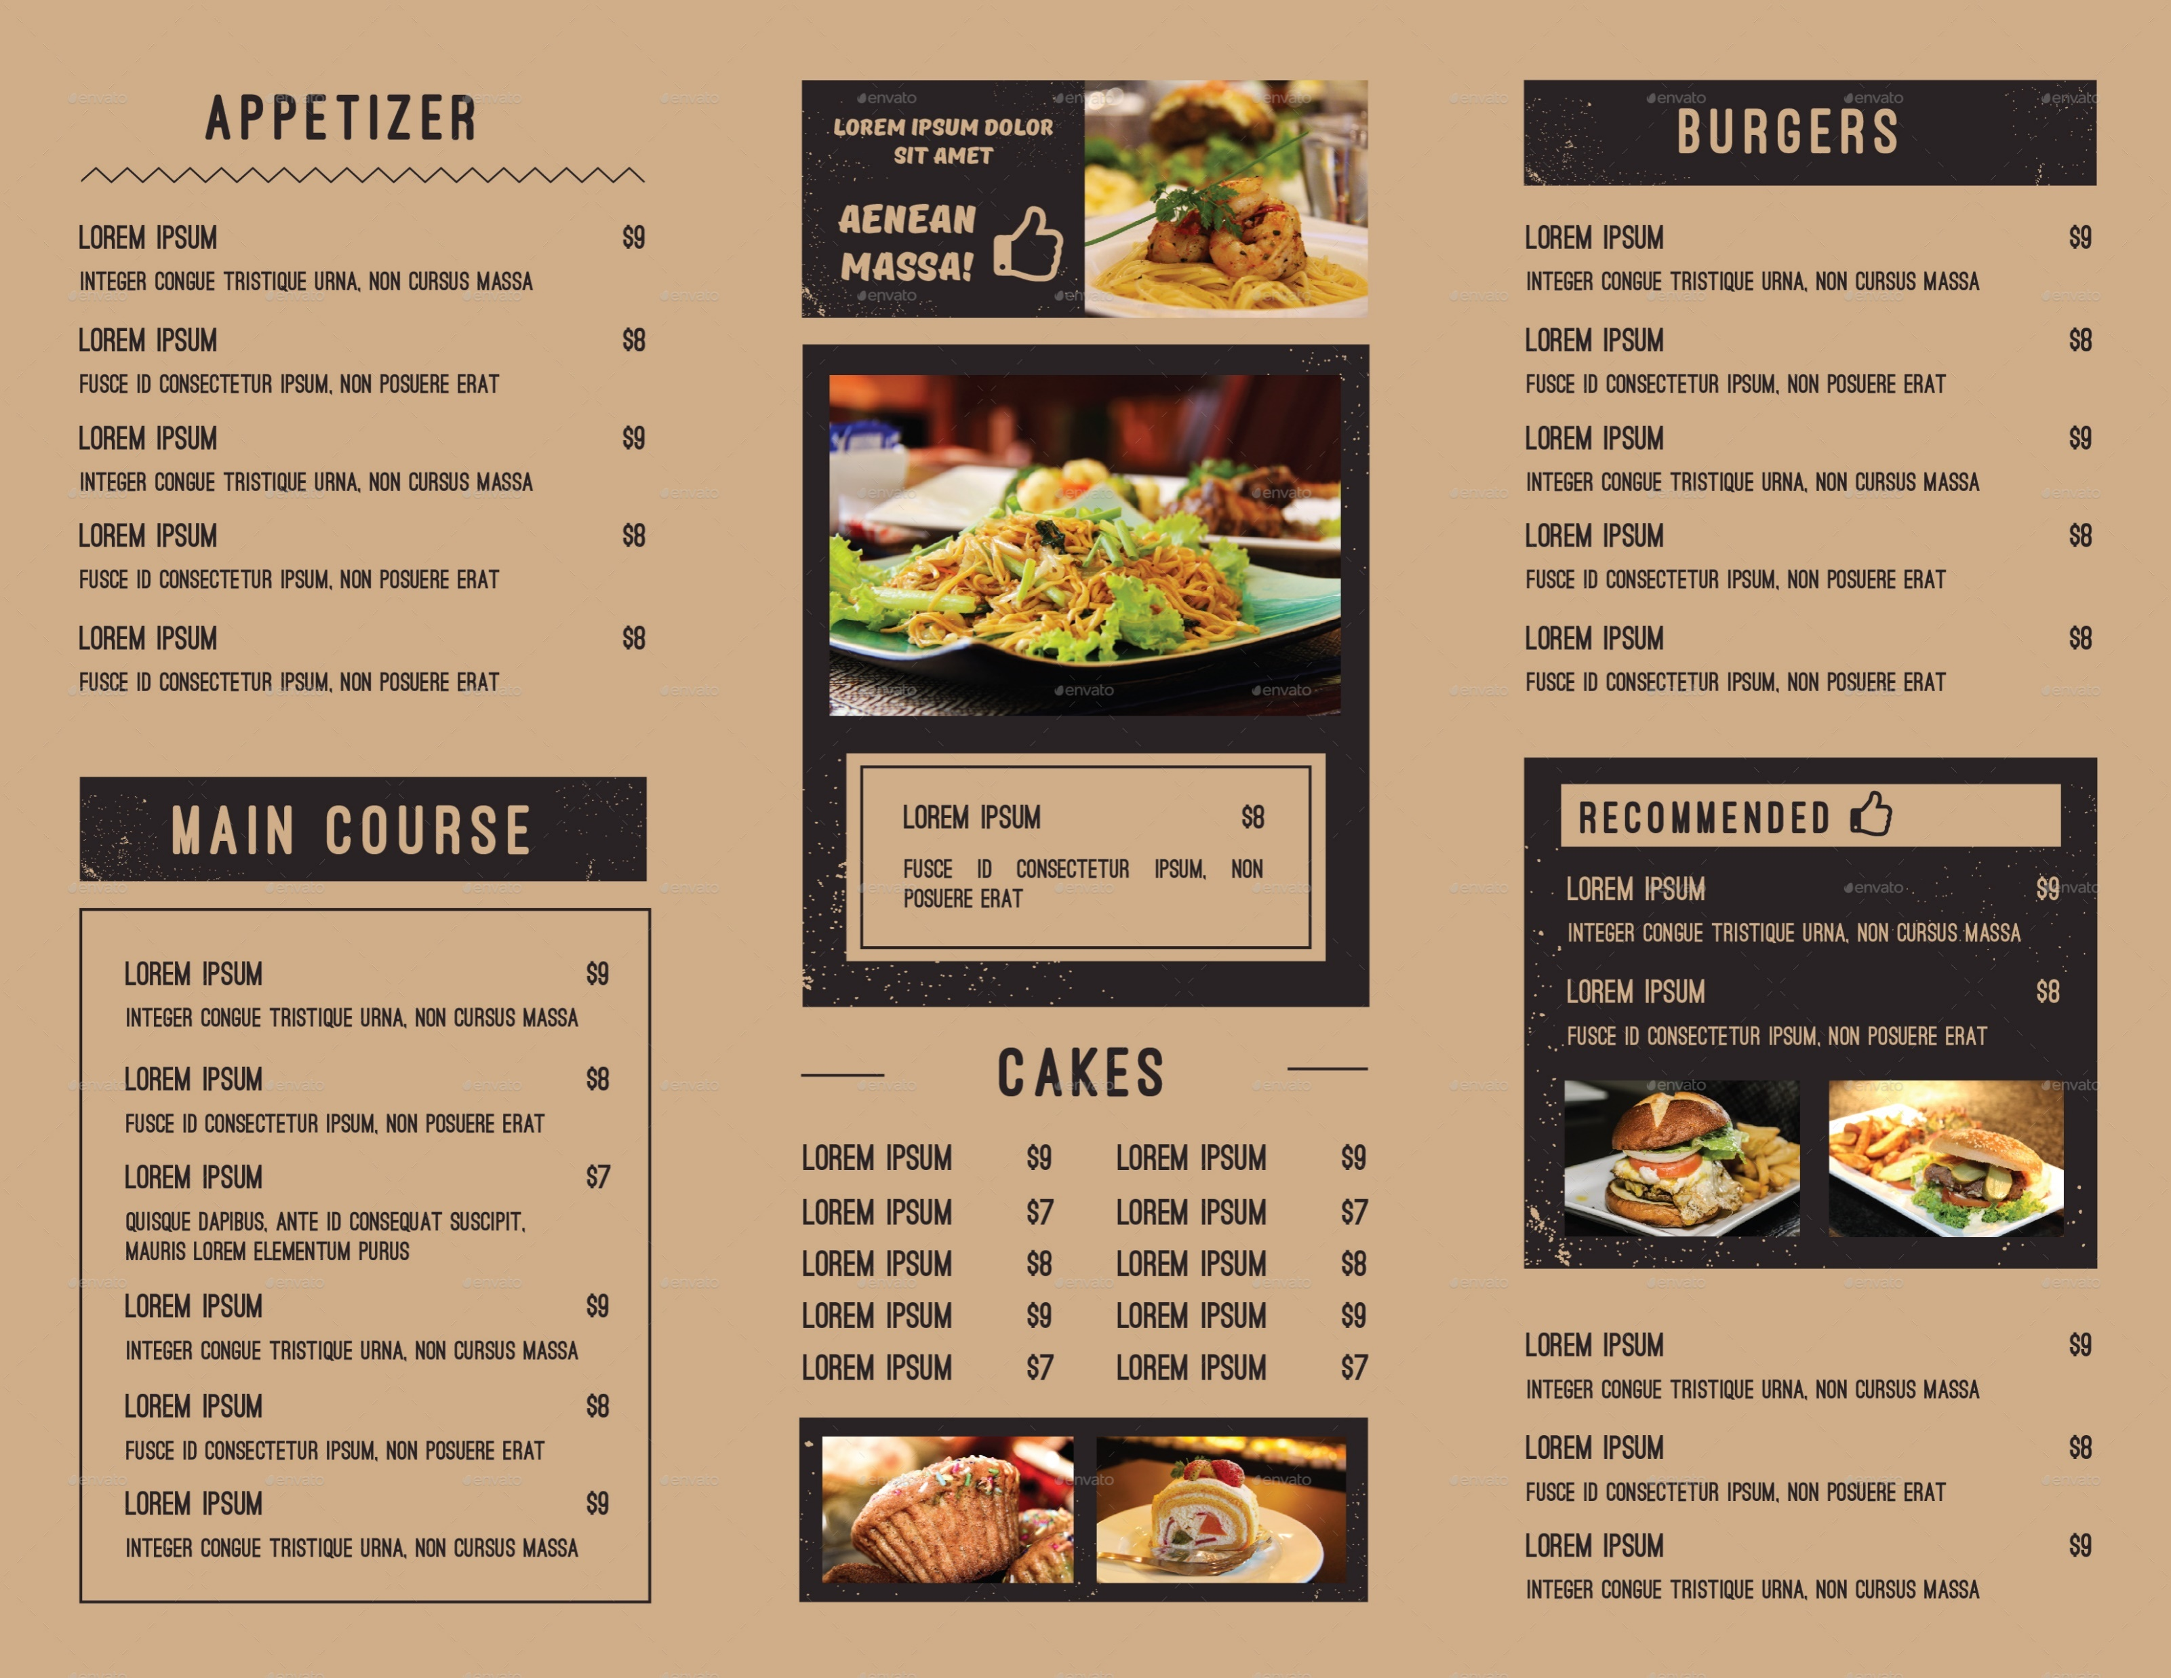
API – What is an API?

Slide 5
API – What is an API?
Decide what Ask the waiter Waiter bring us
you want to bring it our food
What happens here??

Slide 6
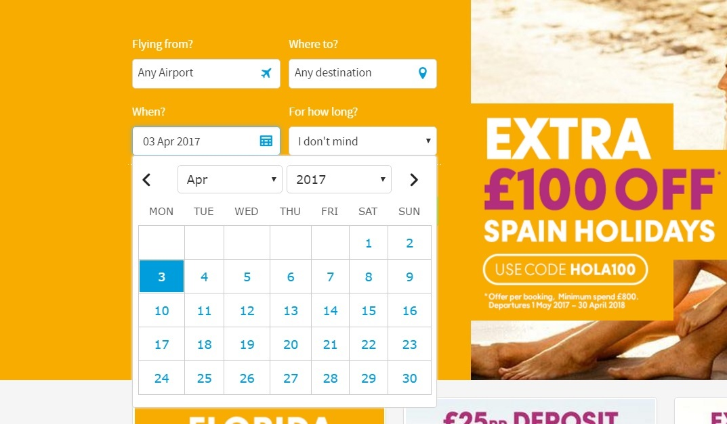
API – What is an API?

Slide 7
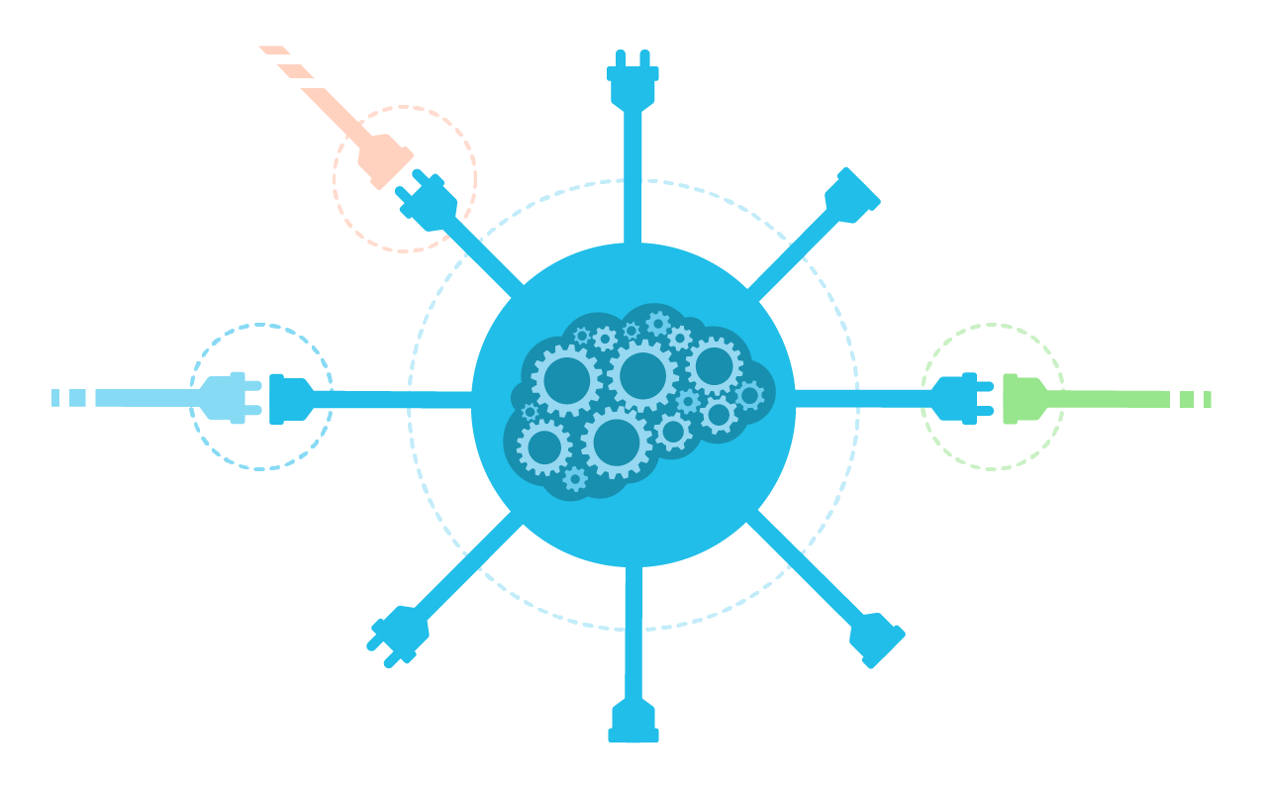
API – What is an API?
Flight Agency API
Hotel API
Cruices API
Museum API
Travel Agency API
CONSUMER
Another API
Another API
Another API

Slide 8
API – What is an API?
Interface to obtain some information
Collection of well-defined methods
Eases the use of certain technologies to developers
Encapsulation of the underlying implementation
Well-documented. Specification to describe its behaviour
Input and output format
Kind of a contract with specific rules

Slide 9
API – What is an API?
RecentFileList
+ getList()
+ openFile() CONSUMER
+ isFull()
+ …

Slide 10
Web Services
APIs wrapped into HTTP
Same purpose, different environment
Machine-to-machine interoperability through the net, usually using HTTP protocol
SOAP, REST
A WS is an API, but an API may not be a WS
Connetion Endpoint
Well-defined
State and context independency

Slide 11
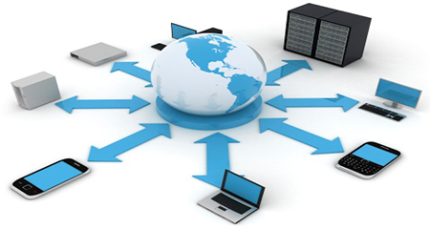
Web Services

Slide 12
Web Services: WSDL
Web Service Description Language
XML Format
Operations and messages described abstractly
Concrete network protocol and message format to define an endpoint
Example: https://www.tutorialspoint.com/wsdl/wsdl_example.htm

Slide 13
Web Services: SOAP
Simple Object Access Protocol
XML-based messaging protocol for exchanging information via internet
Data Transport for Web Services
Platform and language independent
Consists in:
Message: information being exchanged between 2 SOAP nodes
Envelope: enclosing element of an XML message
Header Block
…

Slide 14
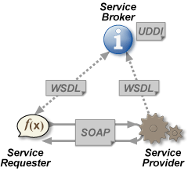
Web Services: all together

Slide 15
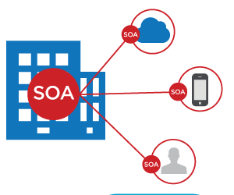
Service Oriented Architecture (SOA)

Slide 16
Homework
Read ‘How to créate services in Java?’. Link: http://www.makinggoodsoftware.com/2009/11/17/how-to-create-services-in-java/
Watch ‘How to design good APIs and why it matters?’ on Youtube. https://www.youtube.com/watch?v=aAb7hSCtvGw
Create a shopping cart API spec.

Slide 17
Questions??

